Slide 1
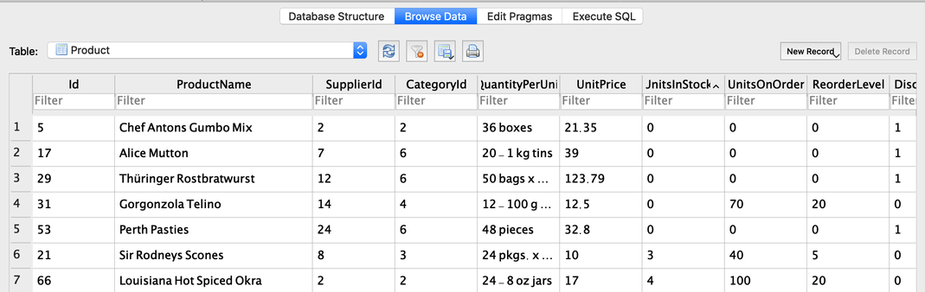
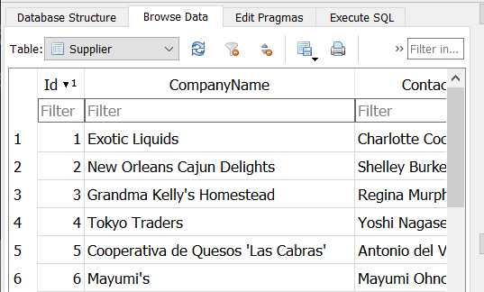
Relations & Joins
Lets put the Relation in Relational Database
‘relational’ refers to representation of relationships among many types of records in the database
Example 1: look at SupplierID in Northwind DBs Product table
Note that SupplierID is a single integer
Is actually a reference to the ID in the Supplier table
rest of details about supplier in that table
Adantage of relational structure:
Efficient, fast, scalable
Many-to-One vs One-to-Many
Every record in the “One” (Supplier) has a unique ID
Every record in the “Many” (Product) has a field that refers to a specific record in the “One” table (in this example SupplierID)

Slide 2
Querying Relations
primary key – a field that is unique for reach record in that table & a reference for other tables
Example: ID from Supplier
foreign key – refers to the primary key in another table
Example: SupplierId and CategoryID
Example 2 – using primary & foreign keys in a Query
print out each product along with that product’s suppliers name
SELECT * FROM Product
Then for each row in product table you need the record from the supplier table as follows
SELECT CompanyName FROM Supplier WHERE Id =<the SupplierID from the Product table>

Slide 3
Querying Relations with JOIN
JOIN – temporarily merges tables to make querying simpler
Example 3 – using primary & foreign keys in a Query
print out each product along with that product’s suppliers name
SELECT * FROM Product
JOIN Supplier ON Product.SupplierID=Supplier.Id
Try Example2 and Example3 in DB Browser Side by Side to show that they’re equivalent
JOIN is much simpler than looping through references between tables
make note of the number of fields in each table and after joining

Slide 4
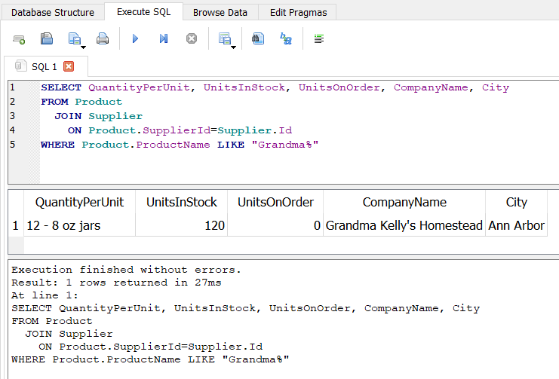
WHERE with JOIN
ON defines a condition for JOIN
See prior example
WHERE can be used to filter the records returned by JOIN
Enter it into DB Broswer and try
SELECT QuantityPerUnit, UnitsInStock, UnitsOnOrder, CompanyName, City
FROM Product
JOIN Supplier
ON Product.SupplierId=Supplier.Id
WHERE Product.ProductName LIKE "Grandma%"

Slide 5
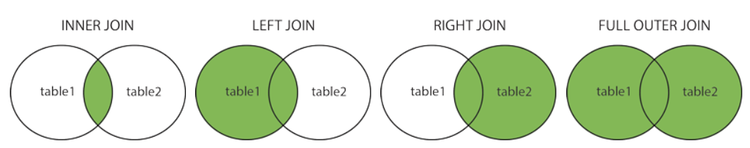
Many kinds of JOINs
INNER JOIN
Selects recrords that meet the values in both tables
All our examples in this course
LEFT (OUTER) JOIN
returns all from left table and matched records from right table
RIGHT (OUTER) JOIN
returns all from right table and matched records from left table
FULL (OUTER) JOIN
Returns all records with a match in both tables
Only INNER JOIN in this class
Optional practice: https://www.w3schools.com/sql/sql_join.asp

Slide 6
Extension Exercise
Use JOIN queries to accomplish the following
Return the ProductName and CategoryName for all products in the category “Condiments”
Return the TerritoryDescription for all Territories in the “Southern” region

Slide 7
Extension Exercise
Use JOIN queries to accomplish the following
Return the ProductName and CategoryName for all products in the category “Condiments”
Return the TerritoryDescription for all Territories in the “Southern” region
import sqlite3
conn = sqlite3.connect('Northwind_small.sqlite’)
cur = conn.cursor()
q1 = '''
SELECT ProductName, CategoryName
FROM Product
JOIN Category ON Product.CategoryId=Category.Id
WHERE CategoryName="Condiments"
'''
q2 = '''
SELECT TerritoryDescription
FROM Territory
JOIN Region
ON Territory.RegionId=Region.Id
WHERE Region.RegionDescription="Southern"
'''
for q in [q1, q2]:
cur.execute(q)
for row in cur:
print(row)
print('-' * 60)
conn.close()

Slide 8
Miscellaneous
What happens if a field or record has a name that is also a SQL keyword?
This happens in the homework assignment – Northwind DB has a table called “Order” which is also a SQL keyword
SELECT * FROM Order #yields a SQL Syntax Error
Solutions use single quotes ‘’ or square brackets [] around the term
SELECT * FROM [Order] #doesn’t return errors
Also useful in Column Names that have spaces
[Date of Birth] #as a hypothetical example

